Slide 1
CDF Plots of
TX Spec Analysis
1/14/2009

Slide 2
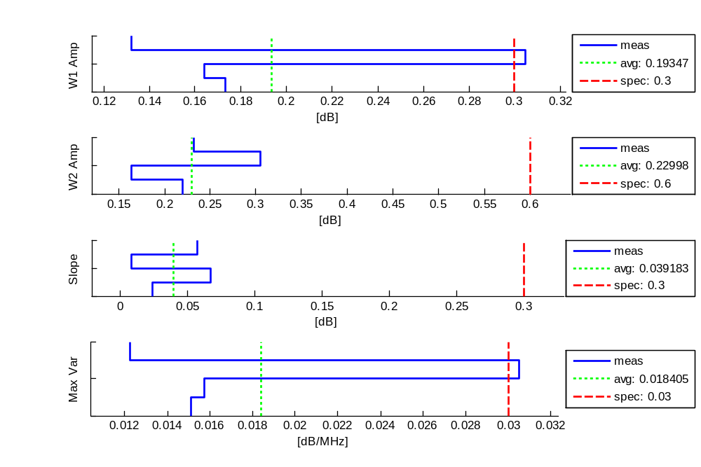
Tx, Ku STD-CDL FL, 15.25GHz - RHCP: Amp Meas
1/14/2009

Slide 3
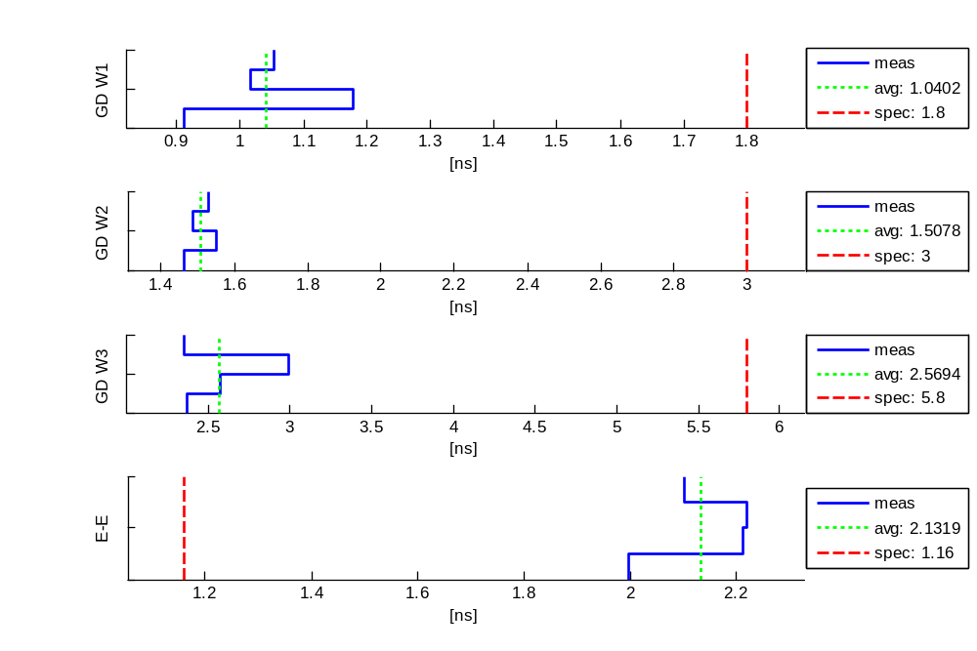
Tx, Ku STD-CDL FL, 15.25GHz - RHCP: Phase Meas
1/14/2009

Slide 4
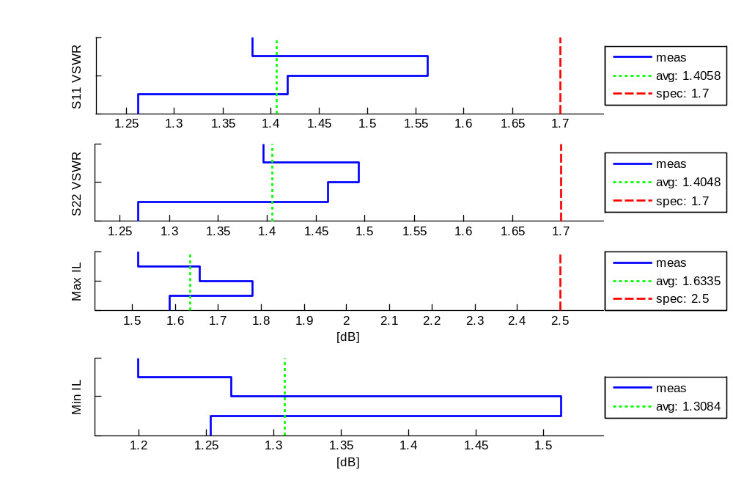
Tx, Ku STD-CDL FL, 15.25GHz - RHCP: Misc Meas
1/14/2009

Slide 5
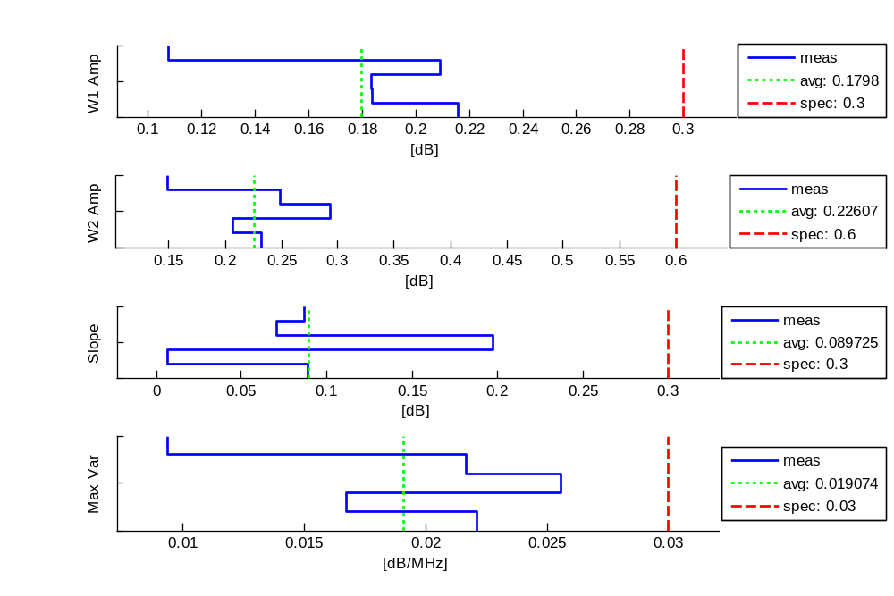
Tx, Ku STD-CDL FL, 15.25GHz - LHCP: Amp Meas
1/14/2009

Slide 6
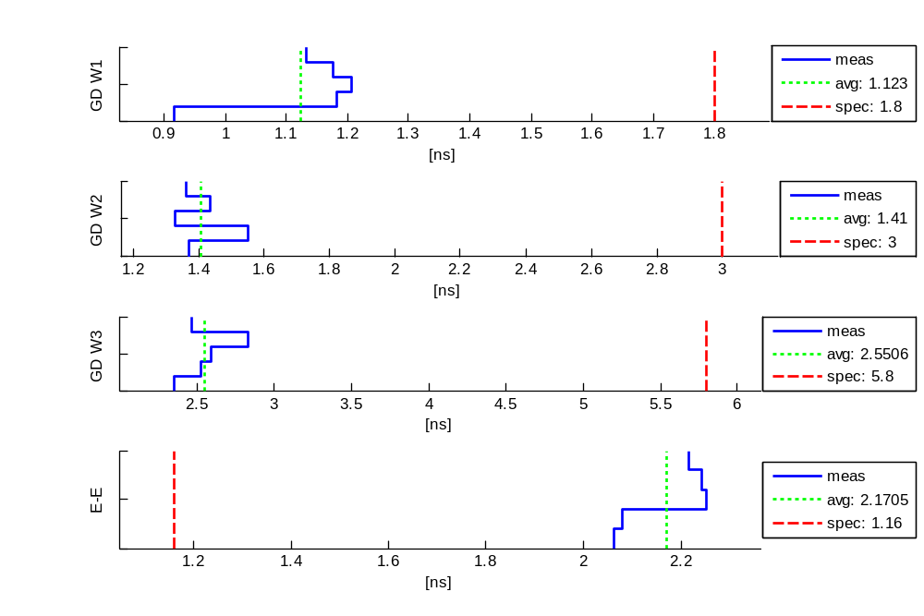
Tx, Ku STD-CDL FL, 15.25GHz - LHCP: Phase Meas
1/14/2009

Slide 7
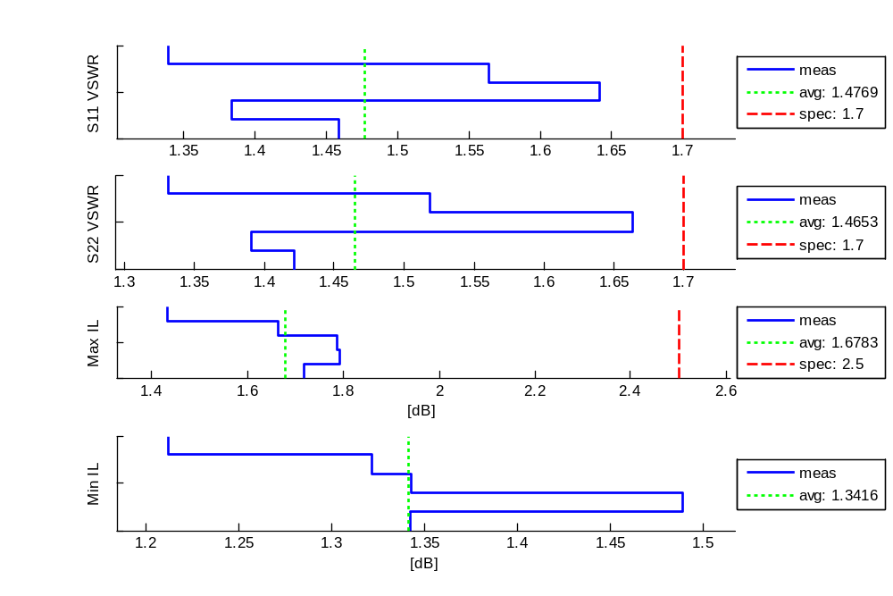
Tx, Ku STD-CDL FL, 15.25GHz - LHCP: Misc Meas
1/14/2009

Slide 8
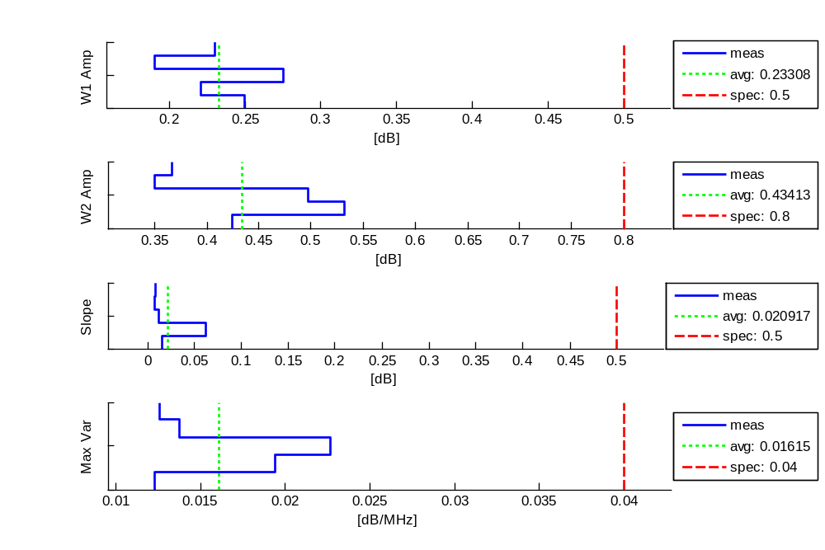
Tx, Ku STD-CDL RL, 14.615GHz - RHCP: Amp Meas
1/14/2009

Slide 9
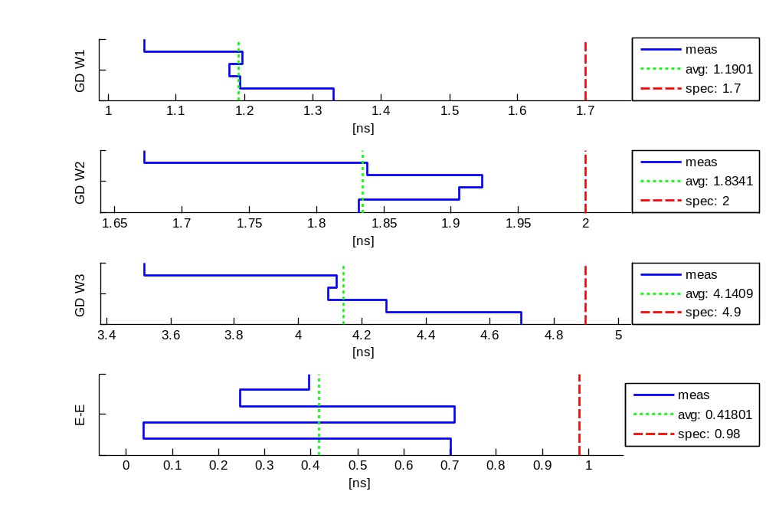
Tx, Ku STD-CDL RL, 14.615GHz - RHCP: Phase Meas
1/14/2009

Slide 10
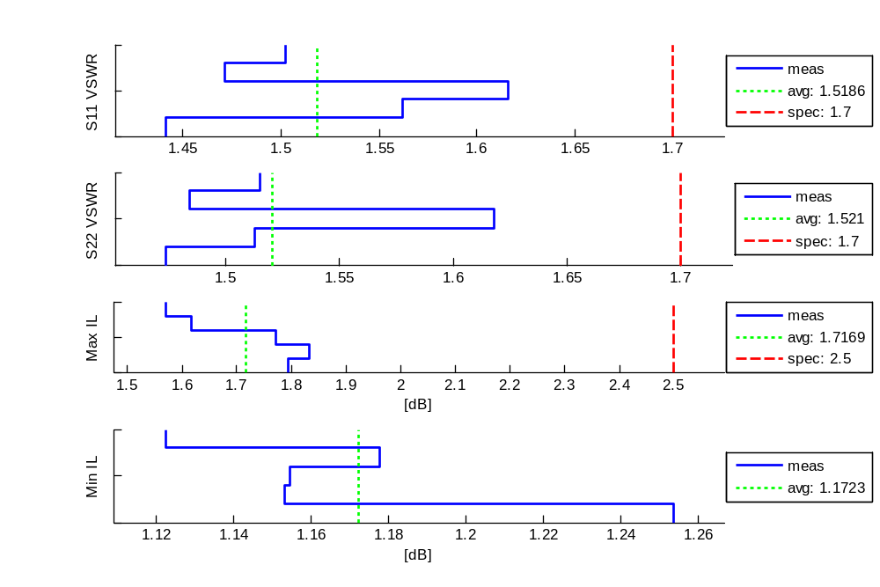
Tx, Ku STD-CDL RL, 14.615GHz - RHCP: Misc Meas
1/14/2009

Slide 11
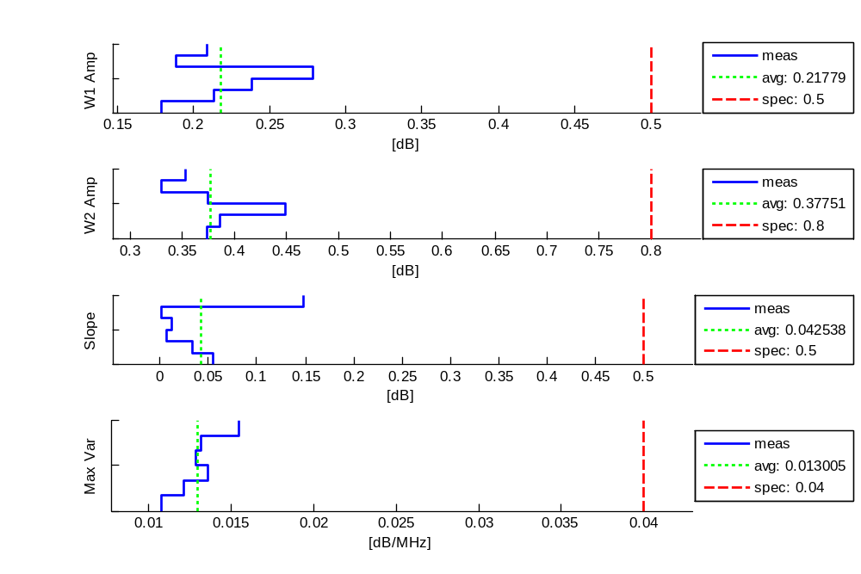
Tx, Ku STD-CDL RL, 14.615GHz - LHCP: Amp Meas
1/14/2009

Slide 12
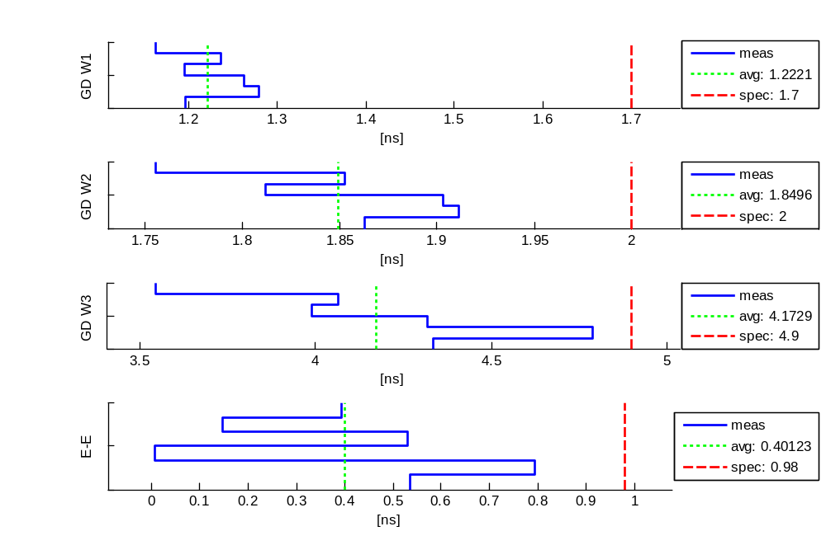
Tx, Ku STD-CDL RL, 14.615GHz - LHCP: Phase Meas
1/14/2009

Slide 13
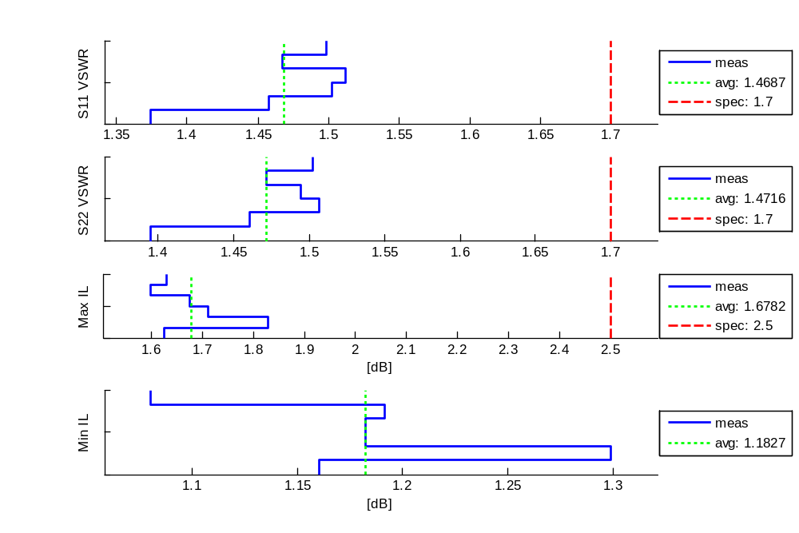
Tx, Ku STD-CDL RL, 14.615GHz - LHCP: Misc Meas
1/14/2009

Slide 14
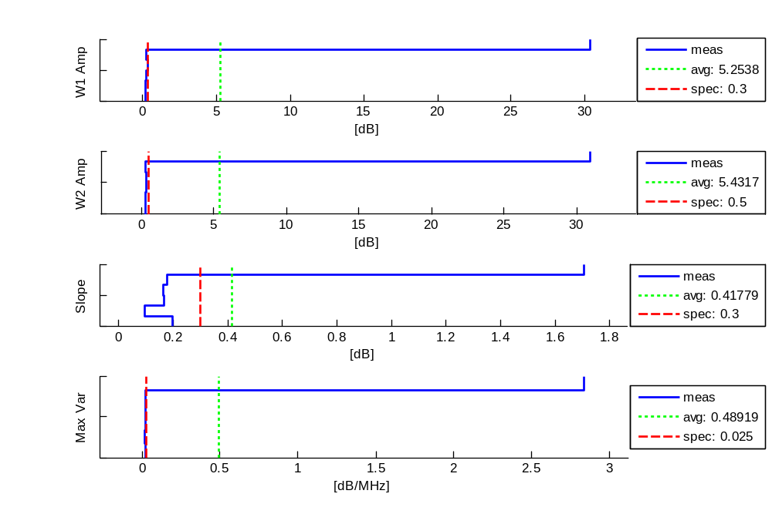
Tx, Ku N-CDL OL, 15.19GHz - RHCP: Amp Meas
1/14/2009

Slide 15
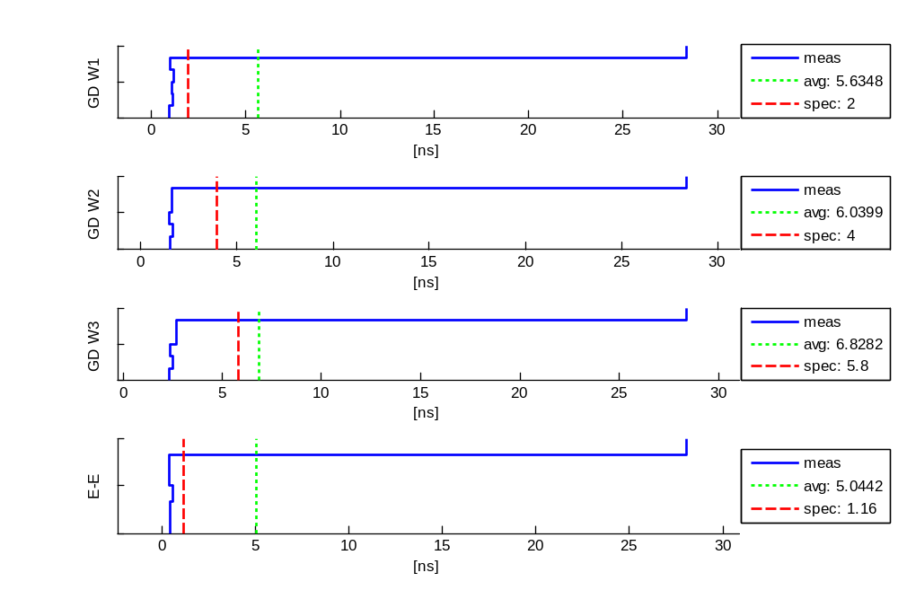
Tx, Ku N-CDL OL, 15.19GHz - RHCP: Phase Meas
1/14/2009

Slide 16
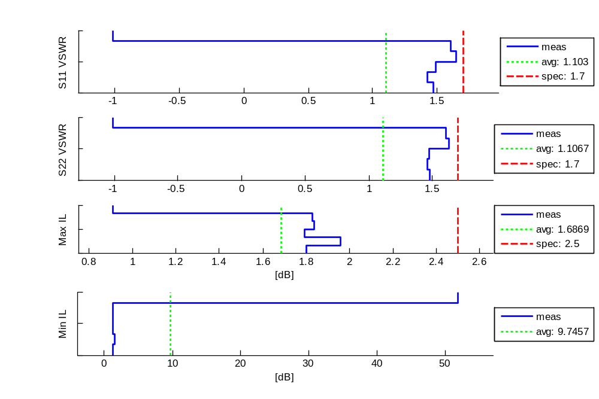
Tx, Ku N-CDL OL, 15.19GHz - RHCP: Misc Meas
1/14/2009

Slide 17
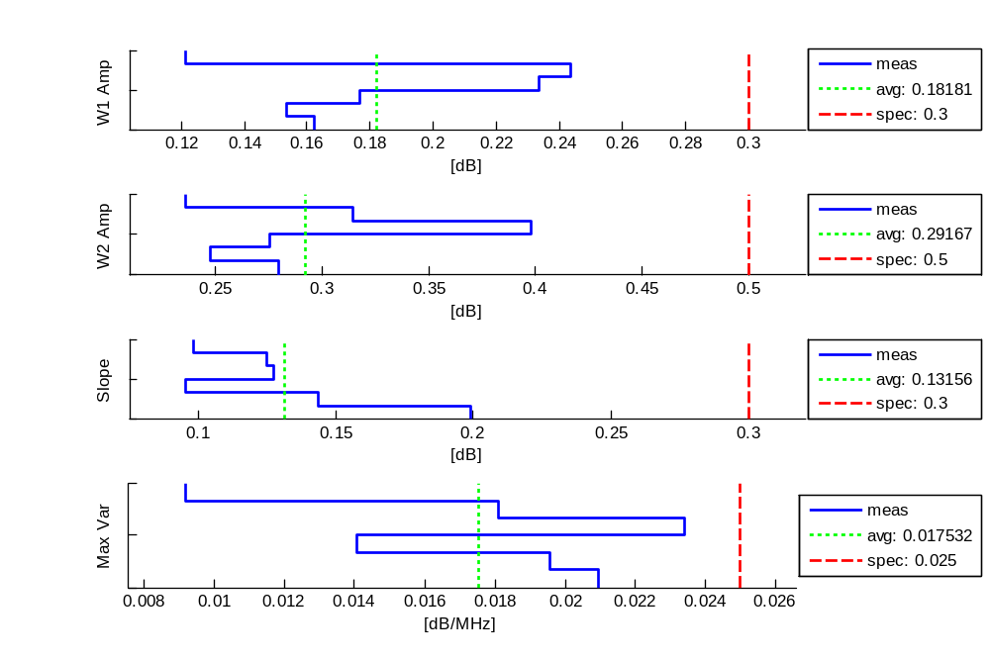
Tx, Ku N-CDL OL, 15.19GHz - LHCP: Amp Meas
1/14/2009

Slide 18
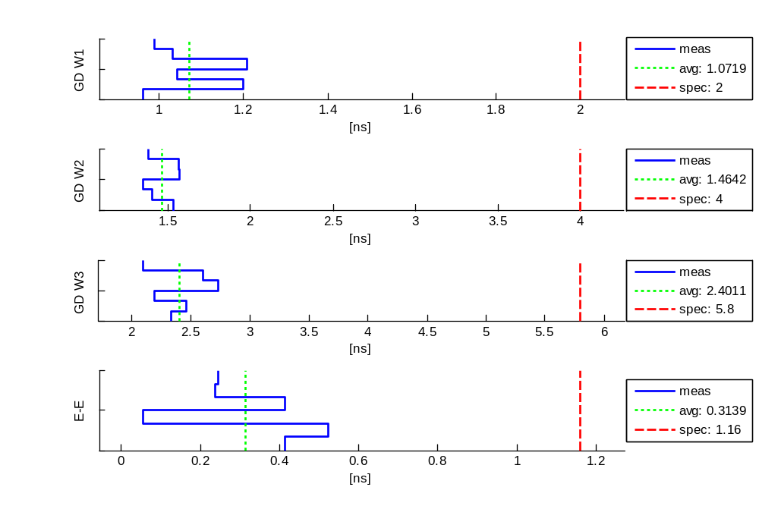
Tx, Ku N-CDL OL, 15.19GHz - LHCP: Phase Meas
1/14/2009

Slide 19
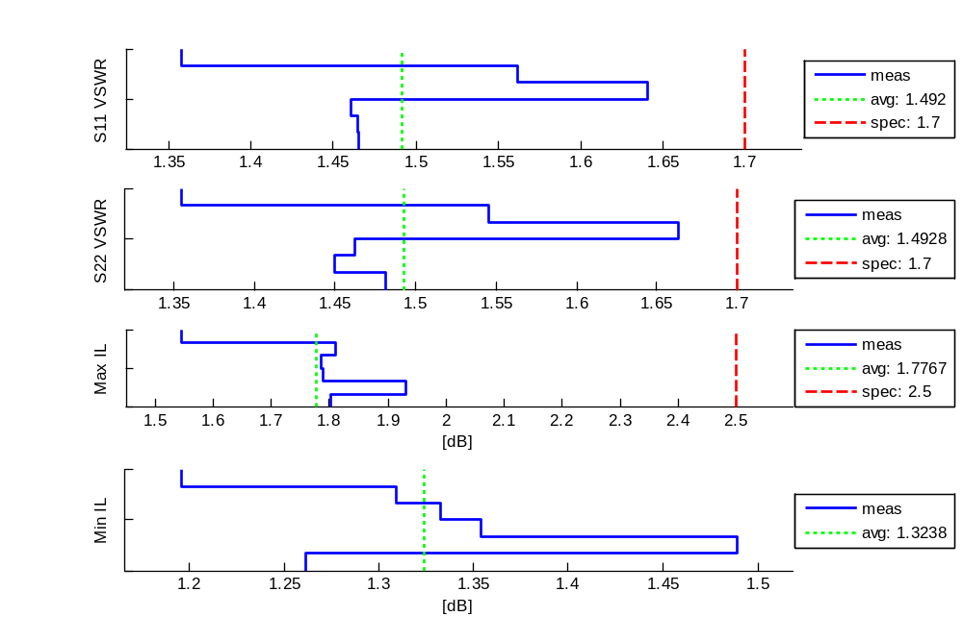
Tx, Ku N-CDL OL, 15.19GHz - LHCP: Misc Meas
1/14/2009

Slide 20
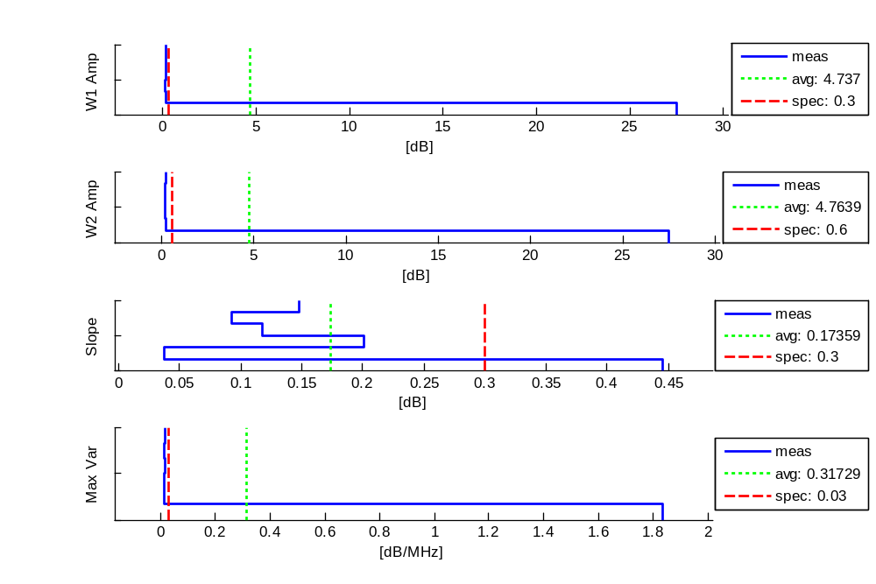
Tx, Ku N-CDL IL, 14.665GHz - RHCP: Amp Meas
1/14/2009

Slide 21
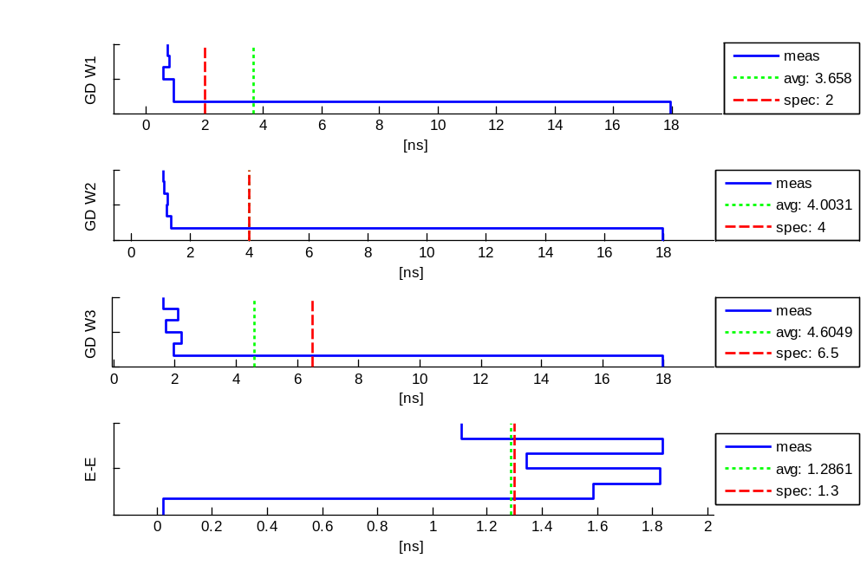
Tx, Ku N-CDL IL, 14.665GHz - RHCP: Phase Meas
1/14/2009

Slide 22
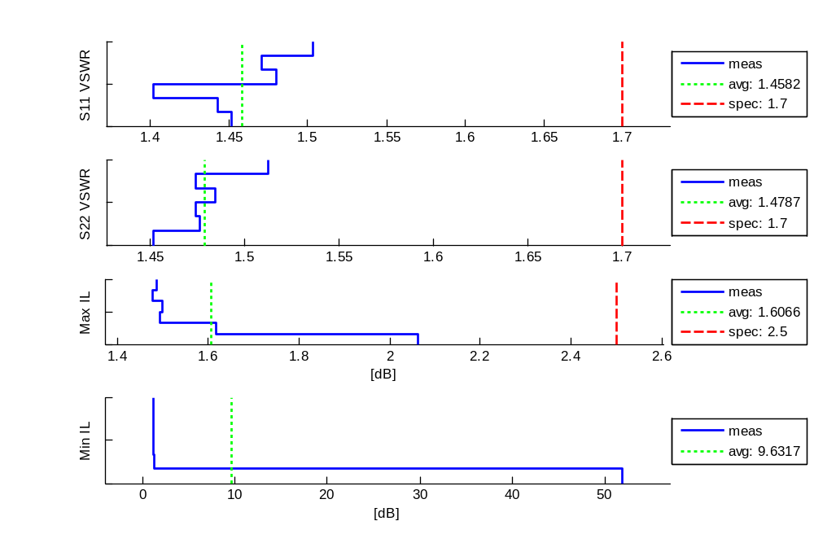
Tx, Ku N-CDL IL, 14.665GHz - RHCP: Misc Meas
1/14/2009

Slide 23
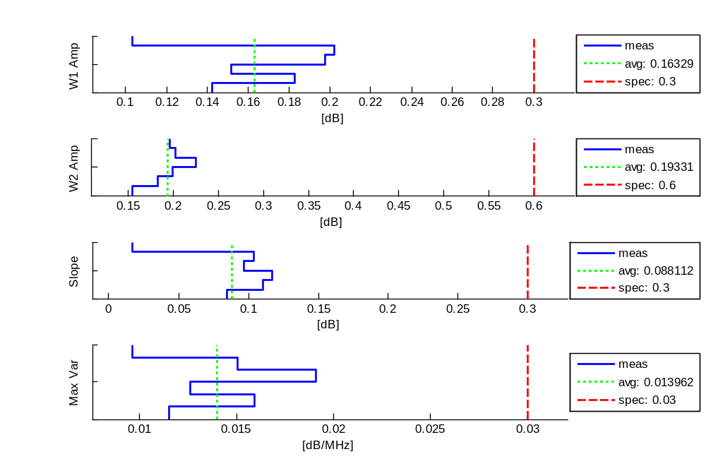
Tx, Ku N-CDL IL, 14.665GHz - LHCP: Amp Meas
1/14/2009

Slide 24
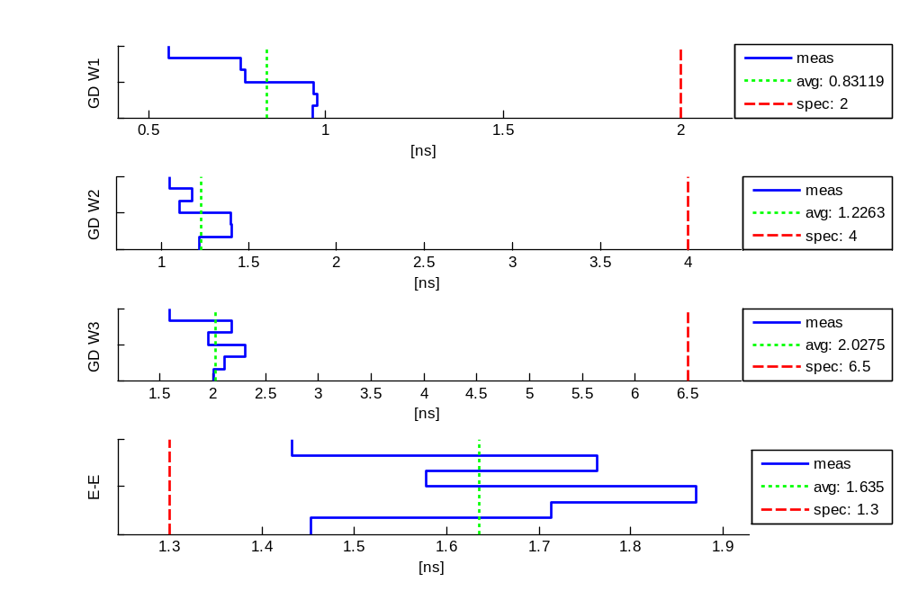
Tx, Ku N-CDL IL, 14.665GHz - LHCP: Phase Meas
1/14/2009

Slide 25
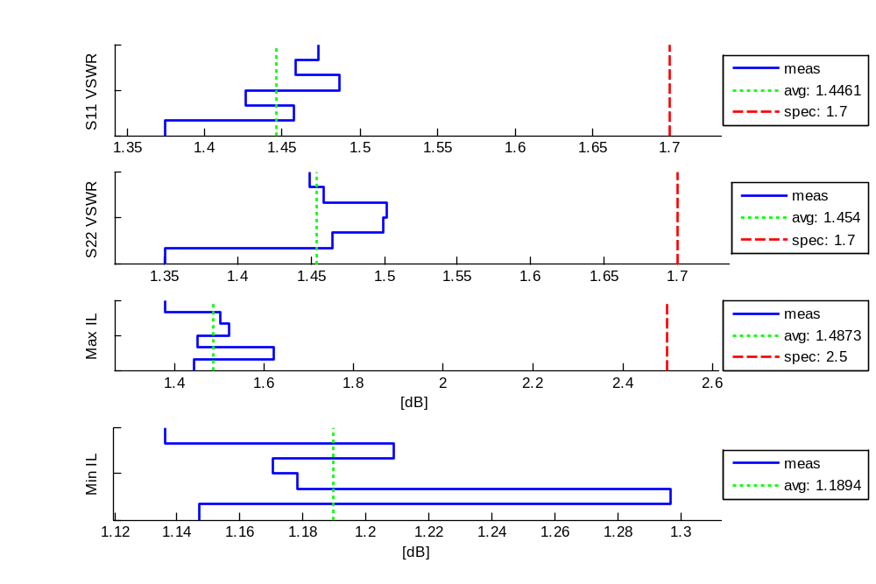
Tx, Ku N-CDL IL, 14.665GHz - LHCP: Misc Meas
1/14/2009

Slide 26
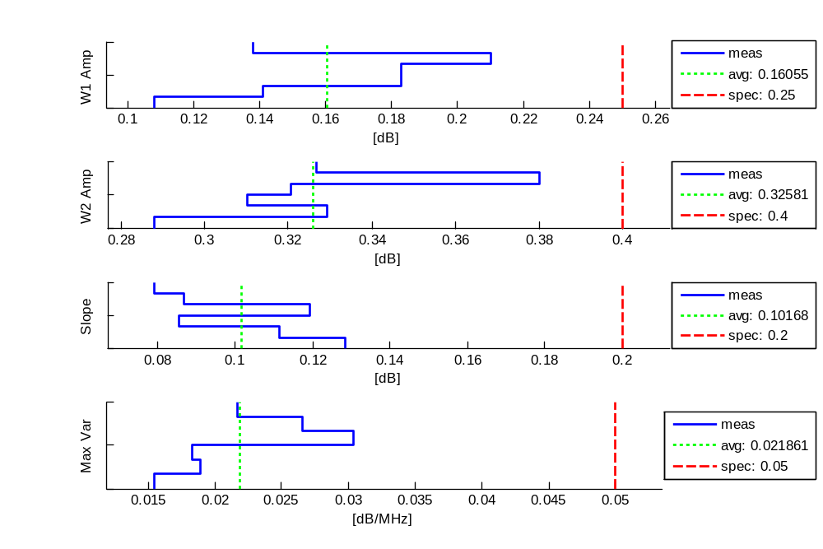
Tx, X STD-CDL FL, 9.85GHz - RHCP: Amp Meas
1/14/2009

Slide 27
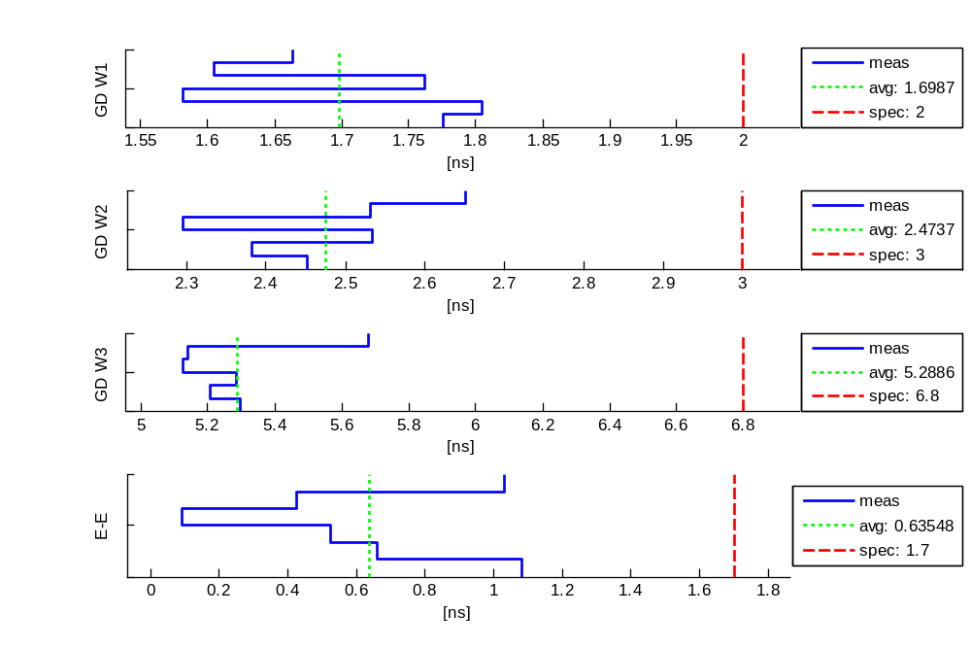
Tx, X STD-CDL FL, 9.85GHz - RHCP: Phase Meas
1/14/2009

Slide 28
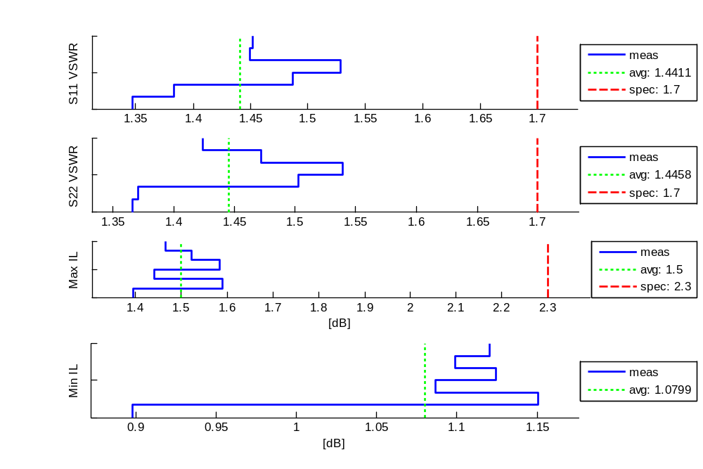
Tx, X STD-CDL FL, 9.85GHz - RHCP: Misc Meas
1/14/2009

Slide 29
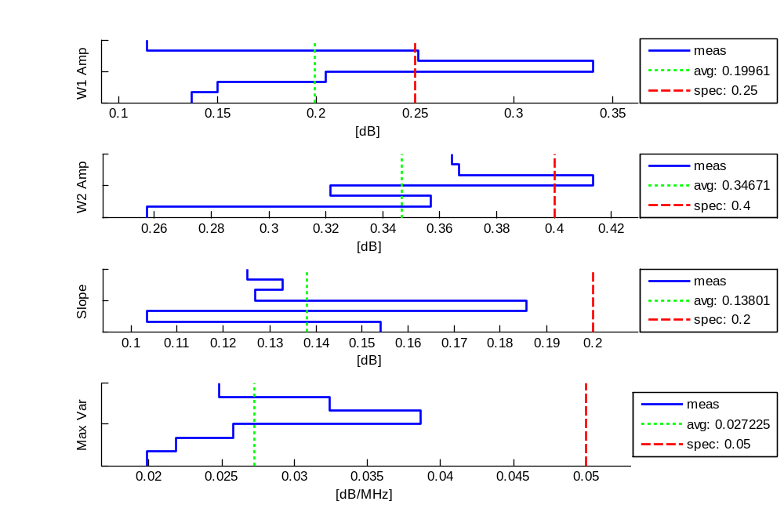
Tx, X STD-CDL FL, 9.85GHz - LHCP: Amp Meas
1/14/2009

Slide 30
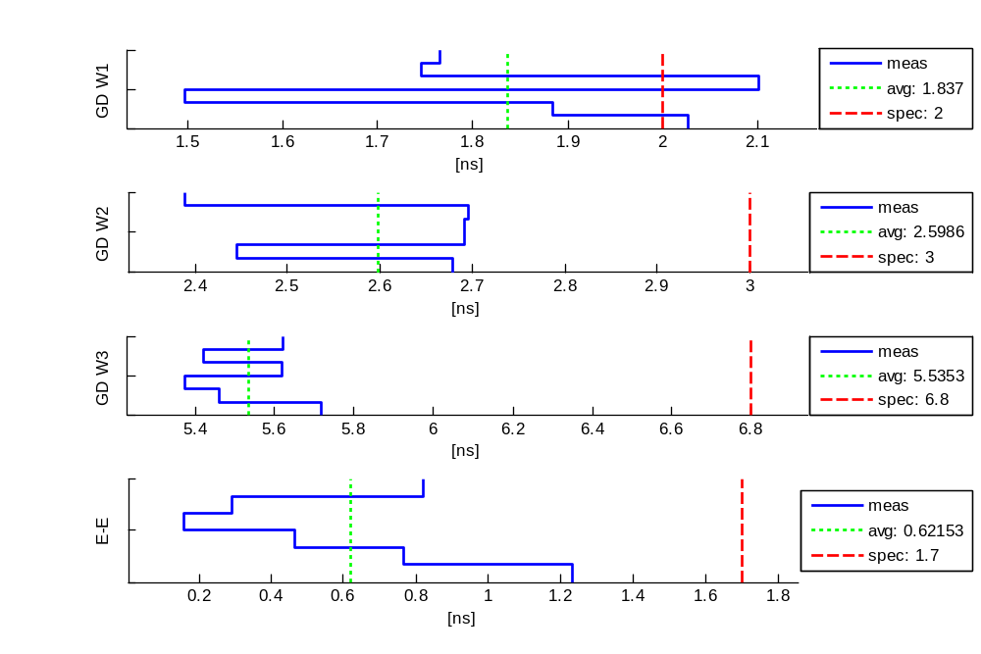
Tx, X STD-CDL FL, 9.85GHz - LHCP: Phase Meas
1/14/2009

Slide 31
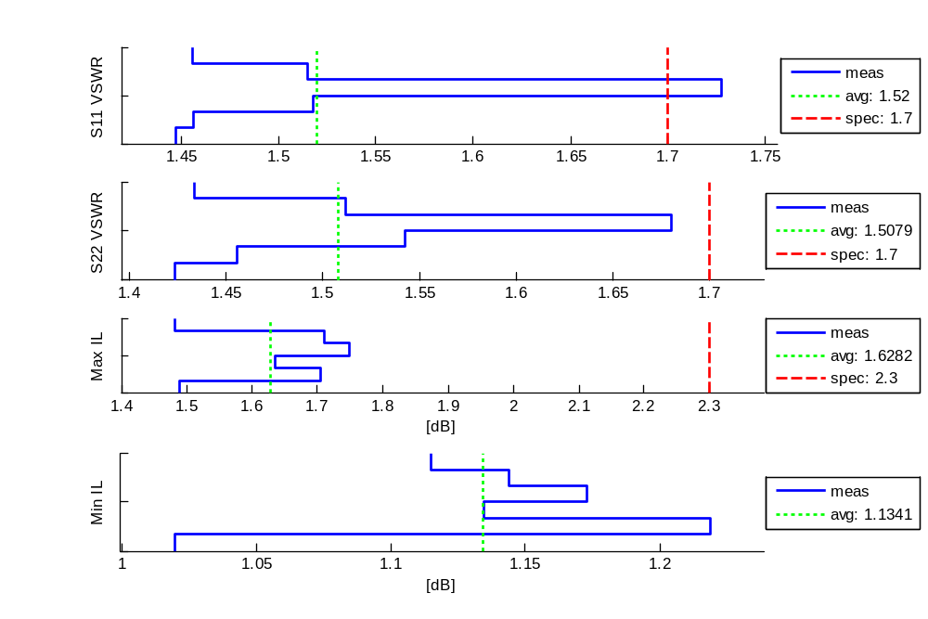
Tx, X STD-CDL FL, 9.85GHz - LHCP: Misc Meas
1/14/2009

Slide 32
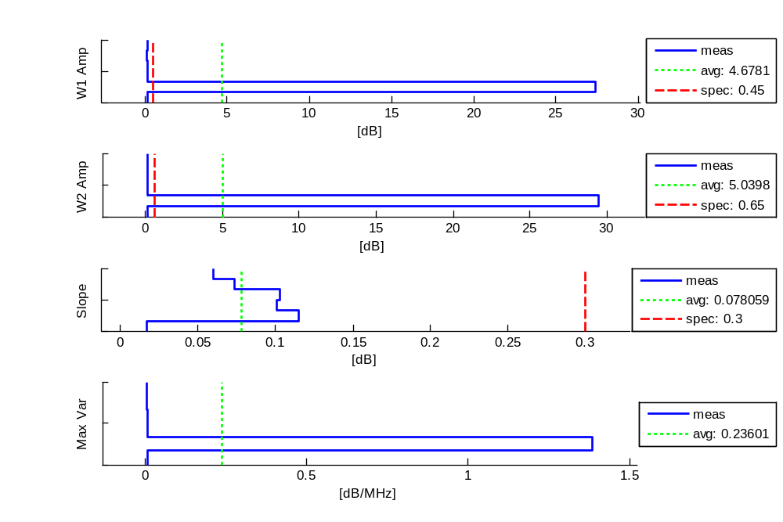
Tx, Ku Intelsat (Tx), 14.125GHz - Linear: Amp Meas
1/14/2009

Slide 33
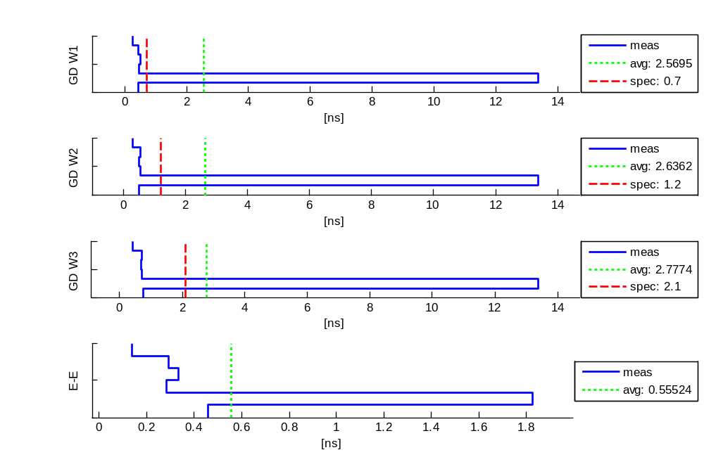
Tx, Ku Intelsat (Tx), 14.125GHz - Linear: Phase Meas
1/14/2009

Slide 34
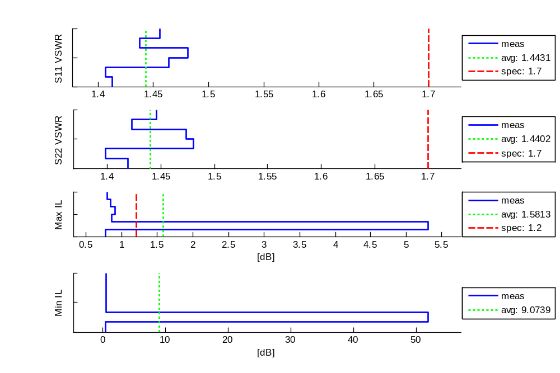
Tx, Ku Intelsat (Tx), 14.125GHz - Linear: Misc Meas
1/14/2009

Slide 35
CDF Plots of
RX Spec Analysis
1/14/2009

Slide 36
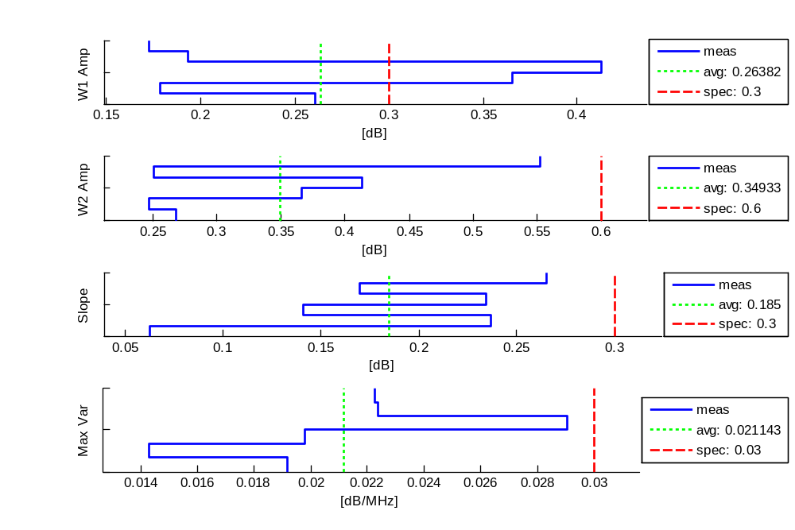
Rx, Ku STD-CDL FL, 15.25GHz - RHCP: Amp Meas
1/14/2009

Slide 37
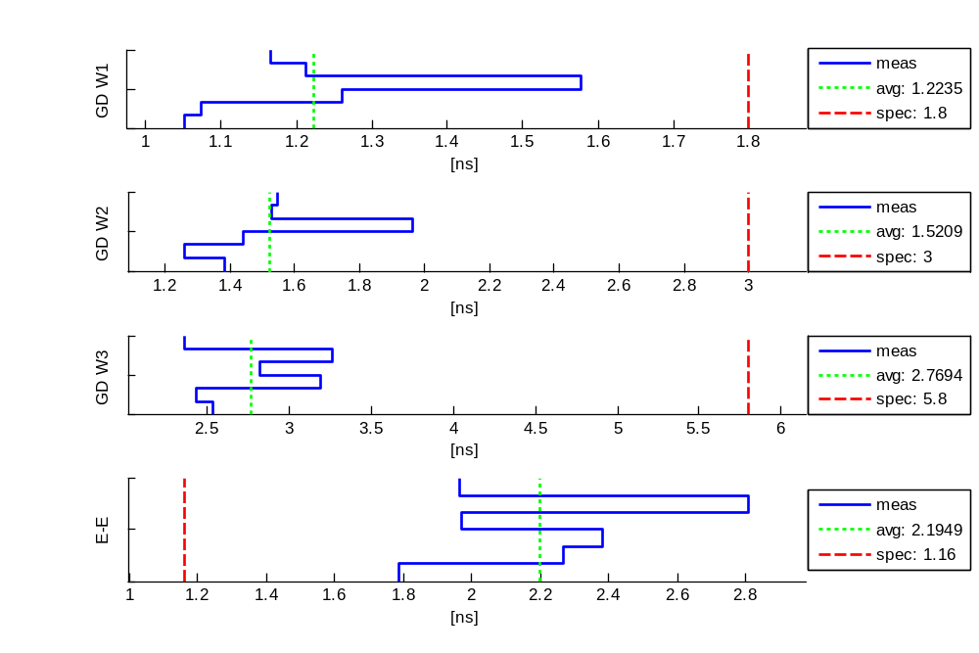
Rx, Ku STD-CDL FL, 15.25GHz - RHCP: Phase Meas
1/14/2009

Slide 38
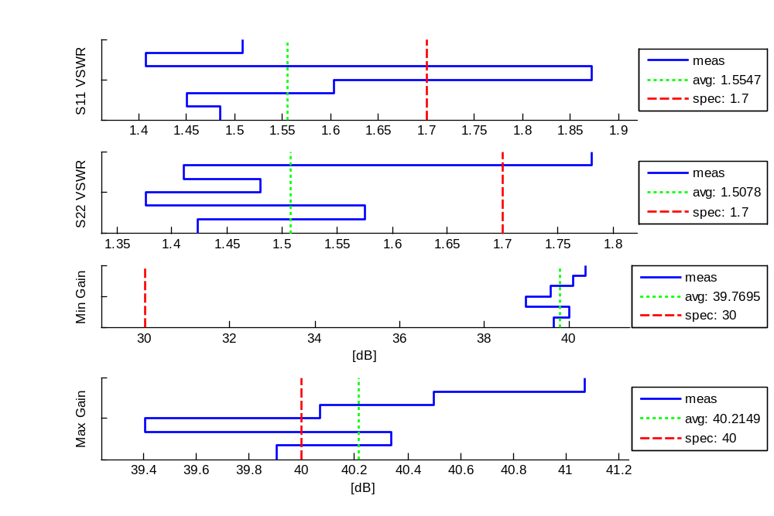
Rx, Ku STD-CDL FL, 15.25GHz - RHCP: Misc Meas
1/14/2009

Slide 39
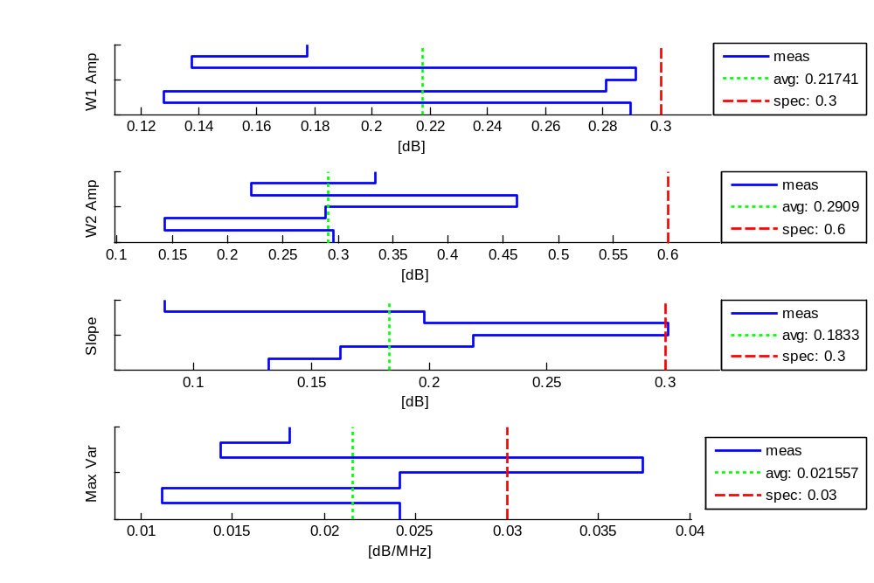
Rx, Ku STD-CDL FL, 15.25GHz - LHCP: Amp Meas
1/14/2009

Slide 40
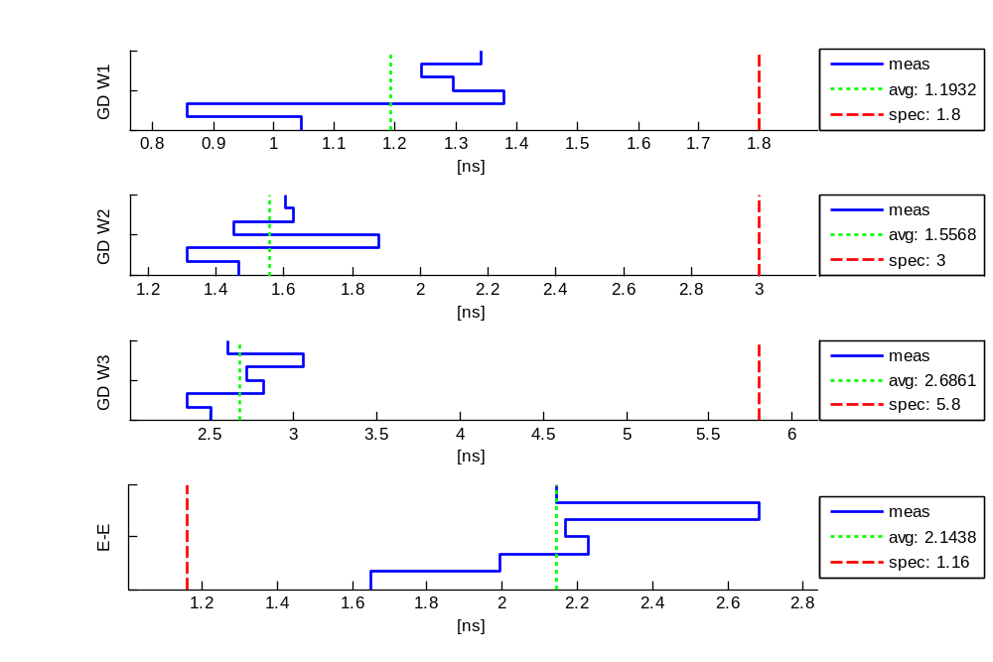
Rx, Ku STD-CDL FL, 15.25GHz - LHCP: Phase Meas
1/14/2009

Slide 41
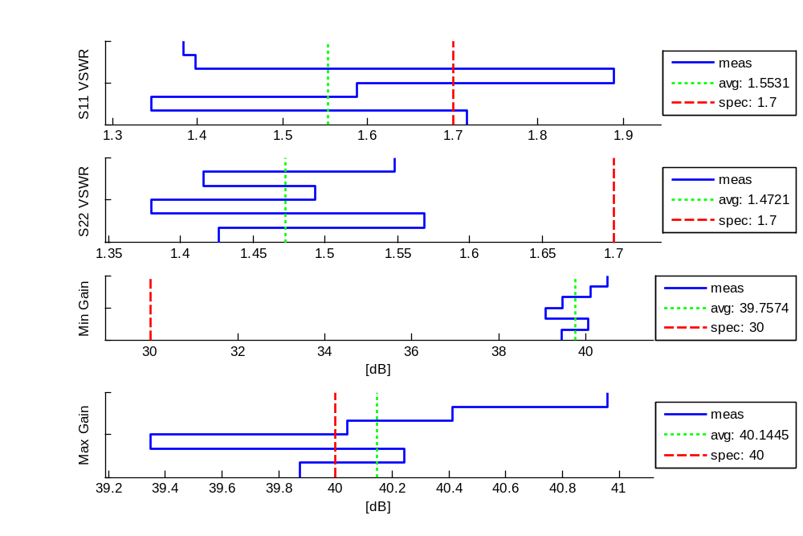
Rx, Ku STD-CDL FL, 15.25GHz - LHCP: Misc Meas
1/14/2009

Slide 42
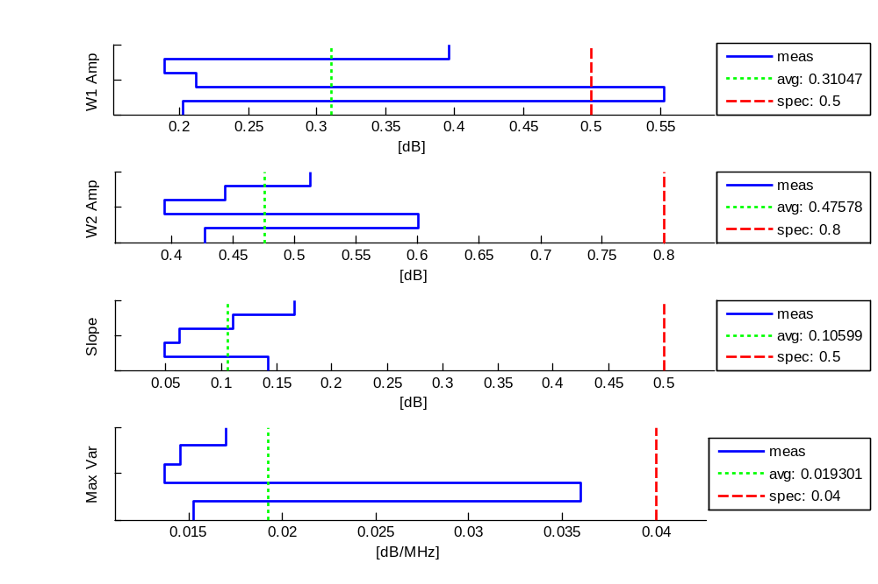
Rx, Ku STD-CDL RL, 14.615GHz - RHCP: Amp Meas
1/14/2009

Slide 43
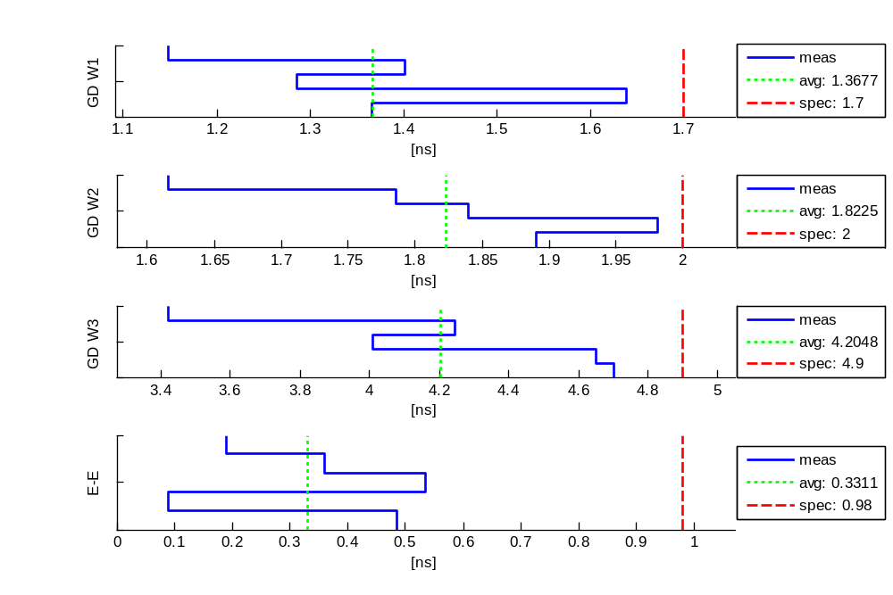
Rx, Ku STD-CDL RL, 14.615GHz - RHCP: Phase Meas
1/14/2009

Slide 44
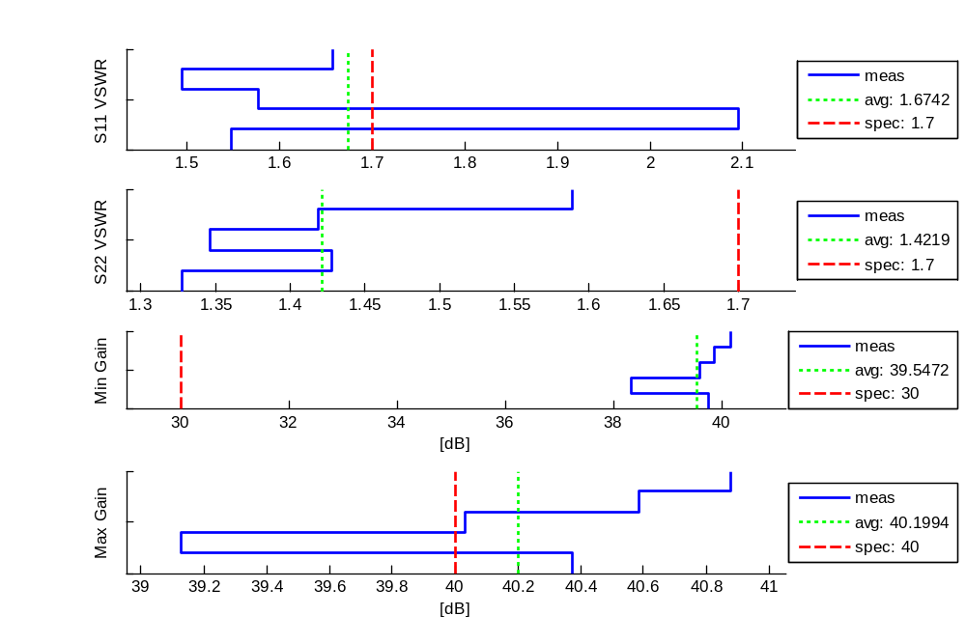
Rx, Ku STD-CDL RL, 14.615GHz - RHCP: Misc Meas
1/14/2009

Slide 45
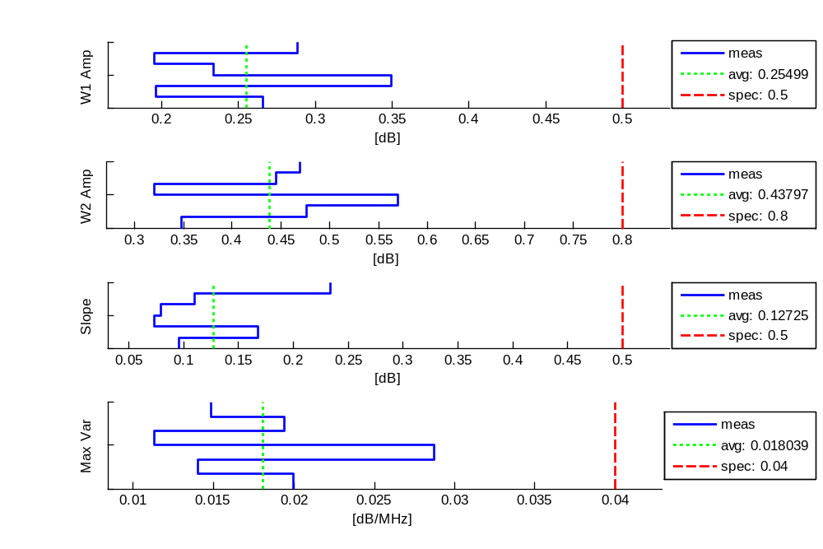
Rx, Ku STD-CDL RL, 14.615GHz - LHCP: Amp Meas
1/14/2009

Slide 46
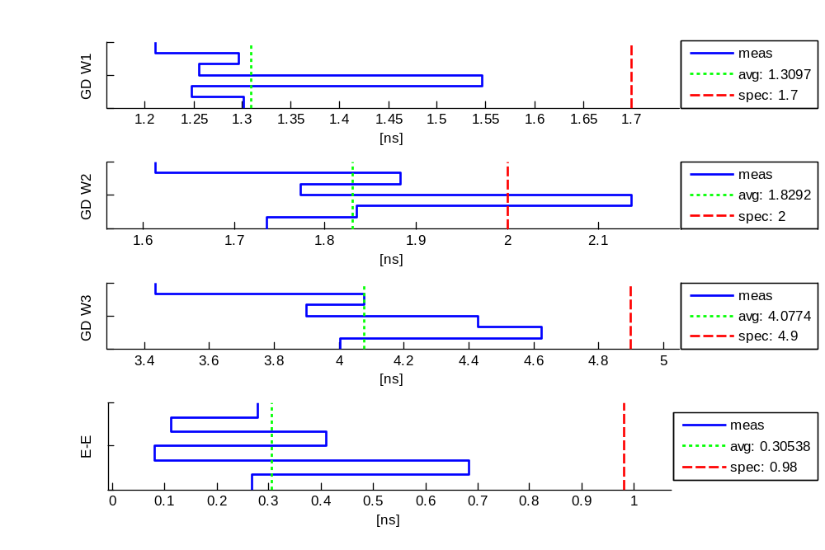
Rx, Ku STD-CDL RL, 14.615GHz - LHCP: Phase Meas
1/14/2009

Slide 47
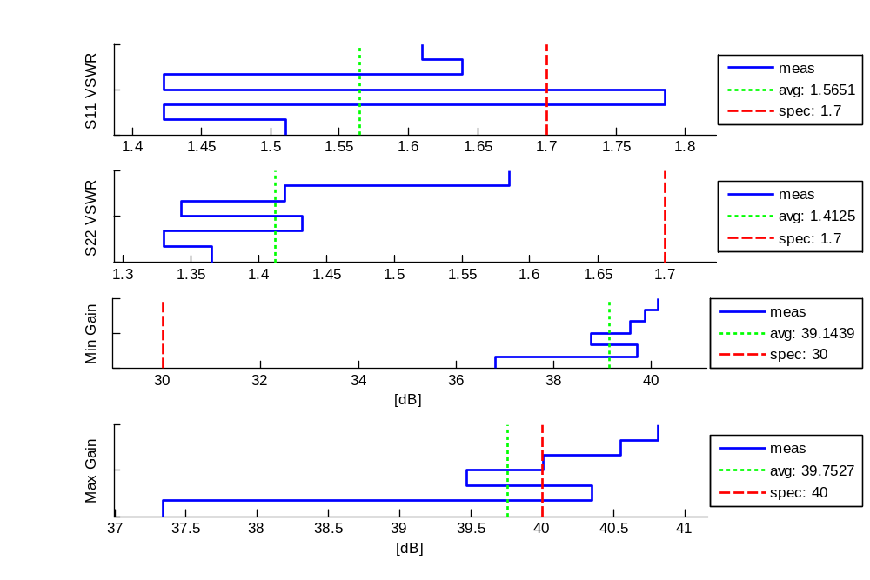
Rx, Ku STD-CDL RL, 14.615GHz - LHCP: Misc Meas
1/14/2009

Slide 48
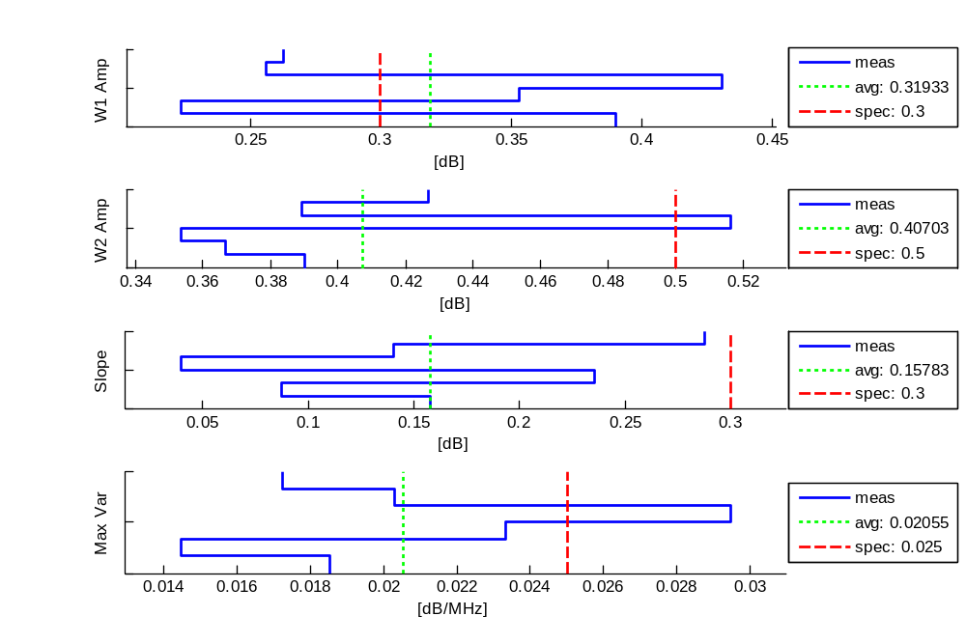
Rx, Ku N-CDL OL, 15.19GHz - RHCP: Amp Meas
1/14/2009

Slide 49
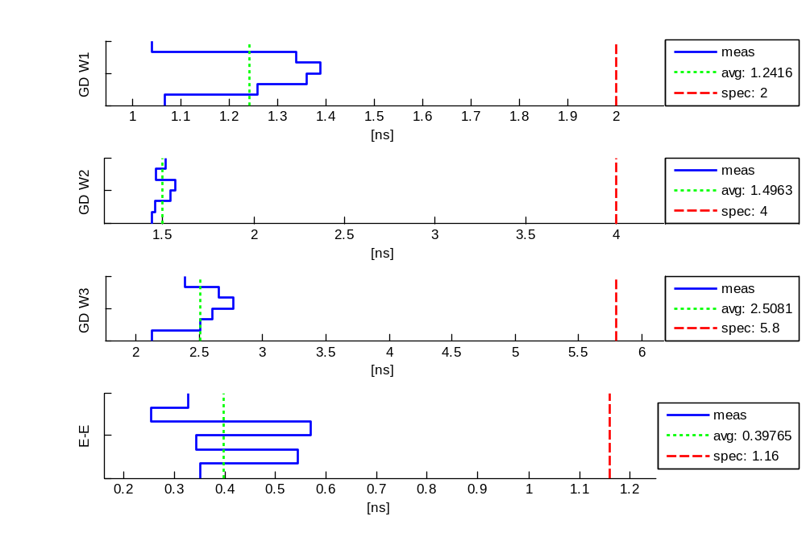
Rx, Ku N-CDL OL, 15.19GHz - RHCP: Phase Meas
1/14/2009

Slide 50
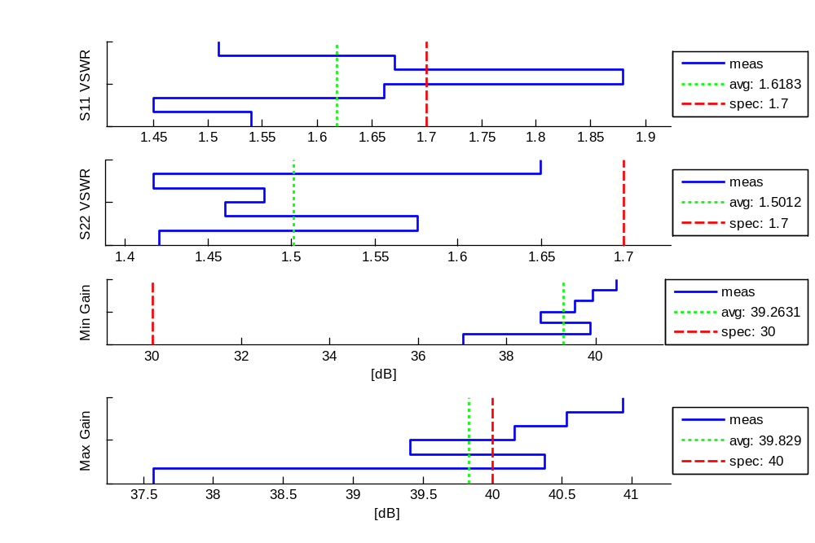
Rx, Ku N-CDL OL, 15.19GHz - RHCP: Misc Meas
1/14/2009

Slide 51
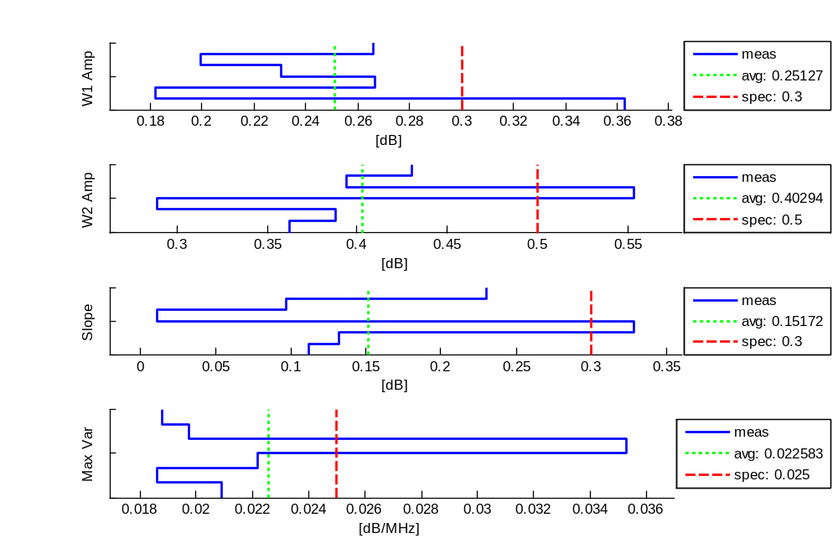
Rx, Ku N-CDL OL, 15.19GHz - LHCP: Amp Meas
1/14/2009

Slide 52
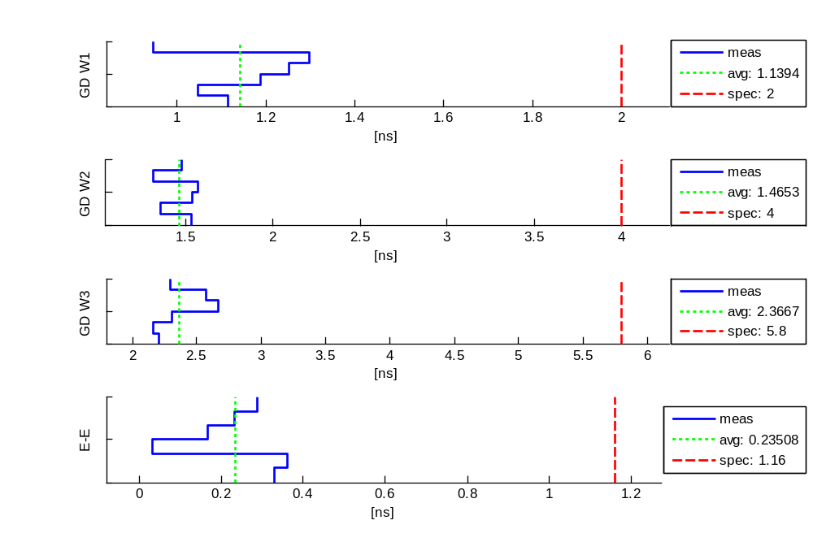
Rx, Ku N-CDL OL, 15.19GHz - LHCP: Phase Meas
1/14/2009

Slide 53

Rx, Ku N-CDL OL, 15.19GHz - LHCP: Misc Meas
1/14/2009

Slide 54

Rx, Ku N-CDL IL, 14.665GHz - RHCP: Amp Meas
1/14/2009

Slide 55

Rx, Ku N-CDL IL, 14.665GHz - RHCP: Phase Meas
1/14/2009

Slide 56

Rx, Ku N-CDL IL, 14.665GHz - RHCP: Misc Meas
1/14/2009

Slide 57

Rx, Ku N-CDL IL, 14.665GHz - LHCP: Amp Meas
1/14/2009

Slide 58

Rx, Ku N-CDL IL, 14.665GHz - LHCP: Phase Meas
1/14/2009

Slide 59

Rx, Ku N-CDL IL, 14.665GHz - LHCP: Misc Meas
1/14/2009

Slide 60

Rx, X STD-CDL RL, 10.3GHz - RHCP: Amp Meas
1/14/2009

Slide 61

Rx, X STD-CDL RL, 10.3GHz - RHCP: Phase Meas
1/14/2009

Slide 62

Rx, X STD-CDL RL, 10.3GHz - RHCP: Misc Meas
1/14/2009

Slide 63

Rx, X STD-CDL RL, 10.3GHz - LHCP: Amp Meas
1/14/2009

Slide 64

Rx, X STD-CDL RL, 10.3GHz - LHCP: Phase Meas
1/14/2009

Slide 65

Rx, X STD-CDL RL, 10.3GHz - LHCP: Misc Meas
1/14/2009

Slide 66

Rx, Ku Intelsat (Rx), 11.85GHz - Linear: Amp Meas
1/14/2009

Slide 67

Rx, Ku Intelsat (Rx), 11.85GHz - Linear: Phase Meas
1/14/2009

Slide 68

Rx, Ku Intelsat (Rx), 11.85GHz - Linear: Misc Meas
1/14/2009

